Slide 1
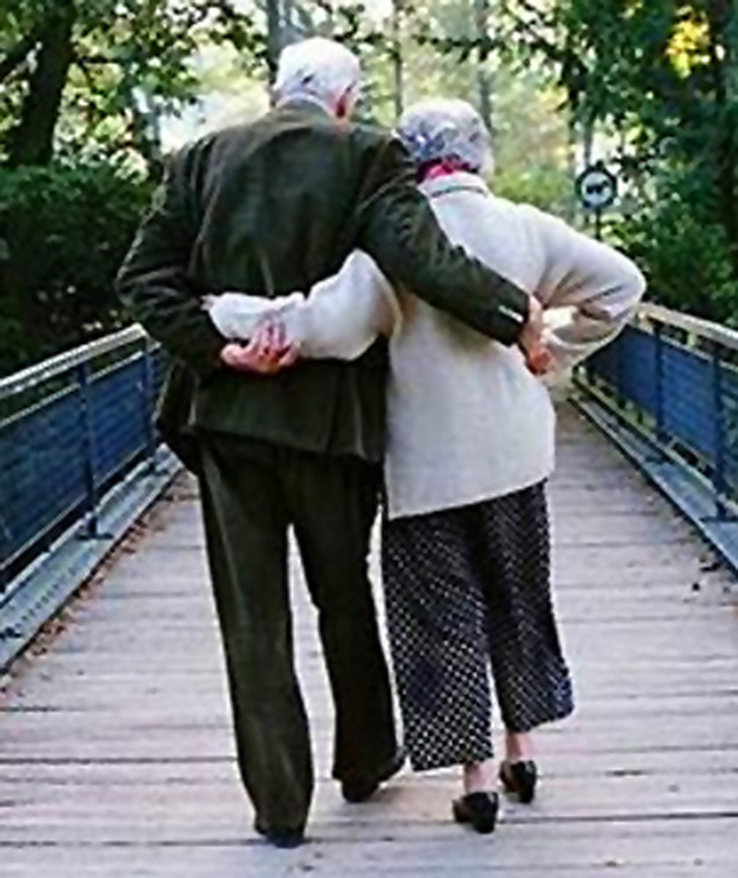
Married: Growing & Serving Together
A Study of Marriage, Spring 2023

Slide 3
So, In Conclusion
Some Final Thoughts…

Slide 4
Spiritual Intimacy Drawing Near to God Individually
“But from there you will seek the LORD your God and you will find him, if you search after him with all your heart and with all your soul.” Dt. 4:29
Understand that there are powerful disrupters
Nothing can replace God

Slide 5
Singleness in God’s Family
Marriage is good and right in God’s sight
So is being single
Christianity holds up both states as honorable.

Slide 6
Marriage is Made in Heaven
In Mt. 19:3, Jesus was questioned about the lawfulness of divorce.
Jesus answered by taking them back to the beginning and quoted Scripture from Genesis – “Have you not read...?”
A women is a strong complementary helper to the so that together, they are complete

Slide 7
Marry Your Best Friend
Your spouse has got to be your best friend or be on the way to becoming your best friend, or you won’t have a strong, rich marriage that endures and that makes you both vastly better persons for having been in it.
From The Meaning of Marriage by Tim and Kathy Keller

Slide 8
Jesus and the Church – A Marriage Model
However, let each one of you love his wife as himself, and let the wife see that she respects her husband. Ephesians 5:33

Slide 9
Love Languages Living Together With “Understanding”
Words of Affirmation
Quality Time
Receiving Gifts
Acts of Service
Physical Touch

Slide 10
Romantic Love in Marriage
How do we define romantic love in marriage and how important is it? One possible definition:
Romantic love in a marriage is the passionate, all-consuming affection each spouse feels as a result of years of commitment and a decision to unconditionally love each other in every way, every day.

Slide 11
Sex – Act of Covenant Renewal
“A man thinks “Romance” is spelled S-E-X...
For a woman, “Romance” is spelled C-O-N-N-E-C-T-I-O-N.

Slide 12
Communication in Marriage
The importance of effective communications in marriage
Establishes and builds understanding
Critical in helping resolve conflict
Builds trust
Enhances emotional intimacy

Slide 13
Resolving Conflict
“A happy marriage is the union of two good forgivers” (Robert Quillen).
Loving Communication
Forgiving Love
Serving Love
Achieving Unity
Anger Management

Slide 14
Anger Management
Anger can be compared to the smoke from a hidden fire. The smoke can be harmful itself, but it also alerts us to a fire that needs to be discovered and put out.
“In a healthy relationship, both partners are like smoke detectors... Unresolved or mismanaged anger gives a place to the devil in your home (Eph. 4:26-27).” - Jeff May and Steve Klein, How to Build Your Dream Home
We must learn how to manage anger constructively.

Slide 15
Resolving Conflicts
“Good sense makes one slow to anger, and it is his glory to overlook an offense.” Pr. 19:11

Slide 16
Protecting Your Marriage
“Enjoy life with the wife whom you love, all the days of your vain life that he has given you under the sun, because that is your portion in life and in your toil at which you toil under the sun.” Eccl 9:9

Slide 17
Protecting Your Marriage
Protecting What We Love
We all make decisions about allocating our resources
Personal discretionary time
Energy
Talent

Slide 18
Protecting Your Marriage
Strengthening our individual relationships with God
Effectively managing the worldly influences on our family
Thoughtful allocation our our “resources”
We must keep the purpose of our lives front and center

Slide 19
Marriage is a Covenant The Permanence of Marriage
“She is your partner, the wife of your marriage covenant.” – Mal. 2:14b
“She has abandoned her husband and ignores the covenant she made before God.” – Prov. 2:17

Slide 20
Divorce and Remarriage
“For the LORD, the God of Israel says That I hate divorce…” Malachi 2:16a
“Whoever divorces his wife and marries another commits adultery against her, and if she divorces her husband and marries another, she commits adultery.” Mark 10:11-12

Slide 21
Bringing Them Up Raising Our Children to Love God
Stable, loving, and prioritized relationship between Mom and Dad
Exposure to the teachings of the scripture
Appropriate, loving discipline consistently applied

Slide 22
Bringing Them Up Raising Our Children to Love God
“Children, obey your parents in the Lord, for this is right.” Ephesians 6:1

Slide 23
Giving Our Children What They Most Need
Appropriate, loving discipline consistently applied
Disciplined Thinking
Disciplined Emotions
Disciplined Actions

Slide 24
Discipline and Instruction

